Slide 1
The LionWeb Initiative
at LangDev 2023
Niko Stotz

Slide 2
Mission
To create an ecosystem of interoperable components for building language-oriented modeling tools on the web.
Adopt language engineering
Reduce vendor lock-in
Mix and match components
Foster innovation and incremental improvements

Slide 3
Why – Rationale

Slide 4
How – Activities
Primary: define protocols
meta-metamodel
reference architecture
Secondary: programming language APIs
reference implementations
Also: collaboration hub for components

Slide 5

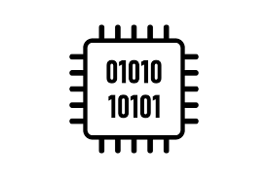
What – Work Products
communication protocol specifications
+ meta-metamodel
reference architecture for cloud-based modeling tools
bindings in several programming languages
reference implementations and examples
Priority

Slide 6
Reference Architecture
1
2

Slide 7
Reference Architecture: Parts
B
C
A
G
1
D
2
F
E
Repository
Model
Original
Derived
Client
Editor
Processor
Model checker
Importer
Generator
A
B
F
G
C
D
E

Slide 8
Reference Architecture: Protocols
1
5
2
4
3
Bulk
Load model, modify, store it back
Load, derive something else
Delta
Initialise with model, get notified of changes, write back changes continuously
2
5
1
4
3

Slide 9
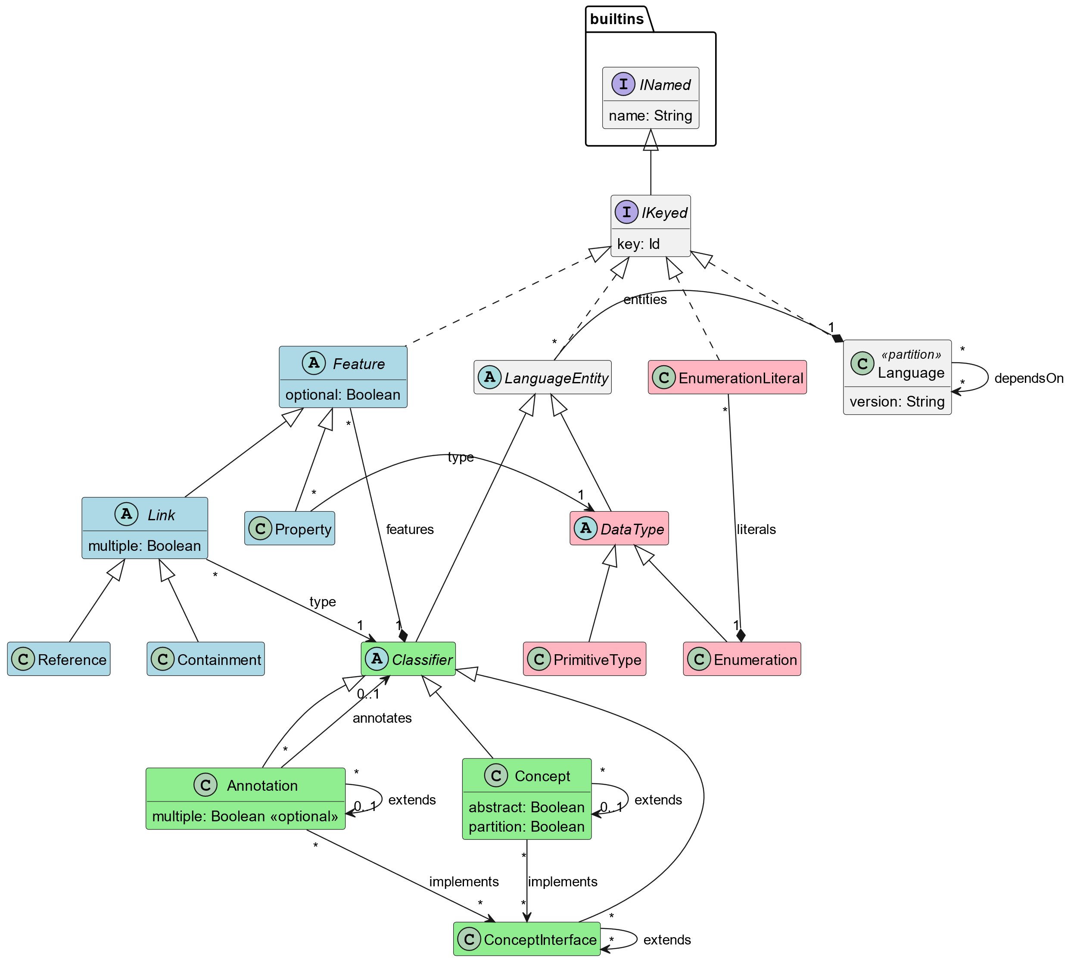
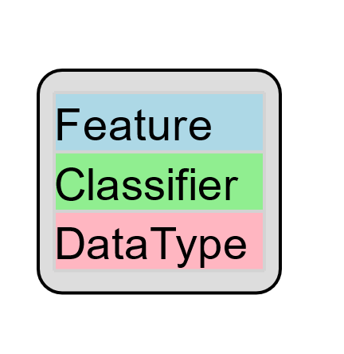
Meta-Metamodel

Slide 10
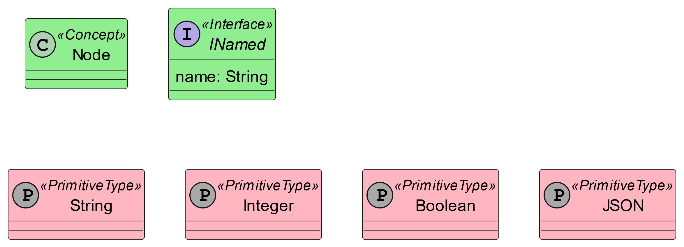
Built-in Standard Library

Slide 11
Who – Participation
Meinte Boersma, Freelancer, The Netherlands
Norman Koester, itemis (modelix Team), Germany
Sergej Koscejev, Freelancer, Czech Republic
Sascha Lisson, itemis (modelix Team), Germany
Eugen Schindler, Canon Production Printing, The Netherlands
Alex Shatalin, Jetbrains (MPS Team), Czech Republic
Niko Stotz, F1RE, The Netherlands
Federico Tomassetti, Strumenta, Italy
Markus Voelter, Freelancer, Germany
Jos Warmer, openmodeling (Freon Team), The Netherlands

Slide 12

Leftovers
All our specifications and code is released as open source under the Apache 2.0. It explicitly allows commercial use. LIonWeb is currently not its own legal entity, it's just a voluntary collaboration of people.

Slide 13
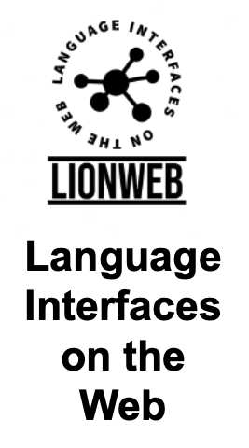
DEMO CONTENTS
Generate LIonWeb metamodel from Kotlin classes
Parse properties file and store as LIonWeb instance model
Import metamodel into MPS
Convert to MPS languages
Import properties instance model into MPS
Show instance model in Freon web editor, served from MPS via LIonWeb protocol
Change some values in Freon
Store changes back to MPS
Export example instance from MPS to LIonWeb
Unparse example instance

Slide 14
EXISTING
EXISTING
PROTOCOLS
CODE
Bulk Read
Bulk Store
APIs in Typescript
APIs in Java/Kotlin
(APIs in C#)
Integration with MPS
Integration with Freon
Integration with Modelix
Integration with StarLasu
Integration with EMF

Slide 15

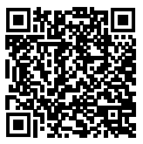
NEAR TERM FOCUS
Finalize Bulk Protocols and document them
Start Work on delta protocols / collaboration
Refine meta-metamodel
Improve reference implementations and examples
Support integration with more tools
If you want to join and work with us, talk to any of the current members.
Or contact us all: info@lionweb.io
If you just want to stay in touch and use our stuff, please join our Slack:
https://join.slack.com/t/lionweb/shared_invite/zt-1uvaly9eb-z529c694OIN5oBh9FH1vhQ

